Slide 1
Choosing statistical methods
Final recap

Slide 2
You will choose statistical methods
Computer-driven data analysis is now important in:
Economics & political science
Public health
Molecular and cell biology
Astronomy & physics
Meteorology & climate science
Many fields of engineering
Fraud detection
…

Slide 3
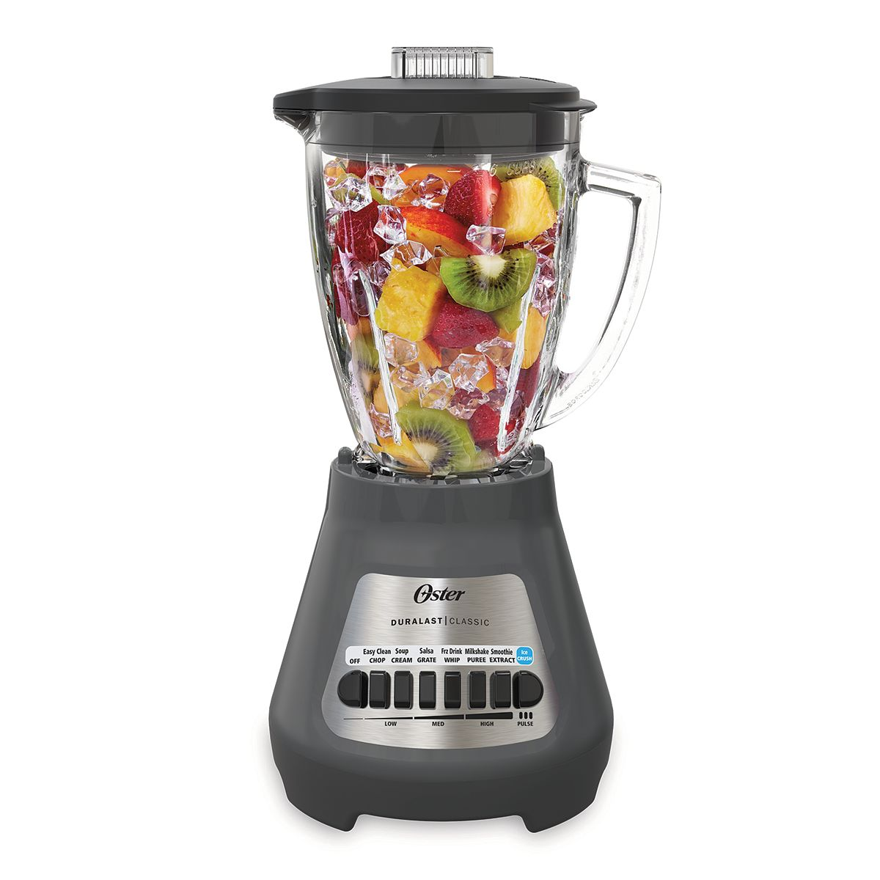


You’ll soon run into this:

Slide 4
Orient yourself and your colleagues by asking “Why?”
And test the answers via simulation studies.

Slide 5
What we did
Programming (lesson 1) and the binomial distribution (lesson 2): fundamental tools to help design simulation studies

Slide 6
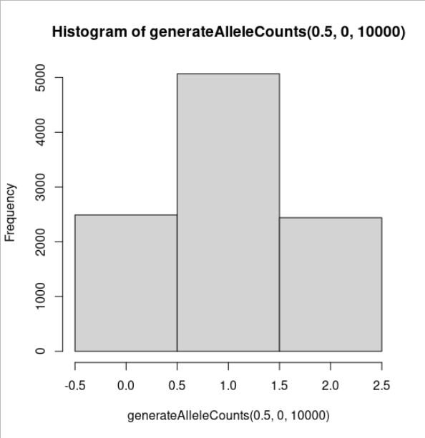
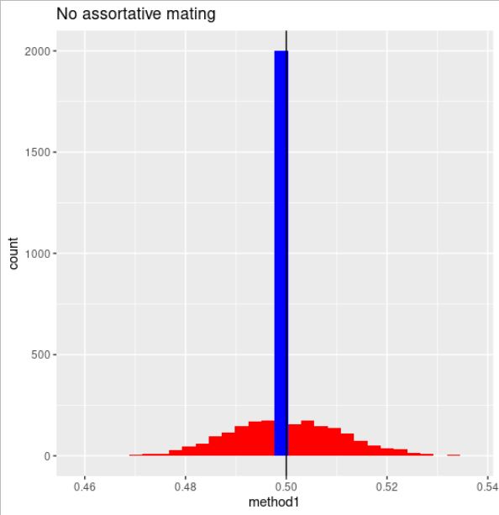
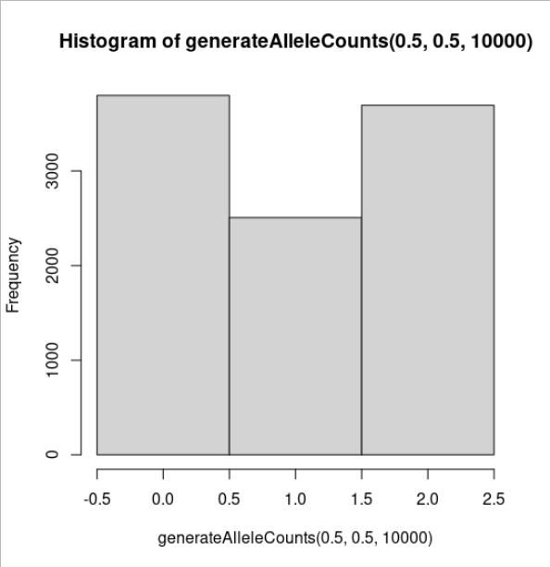
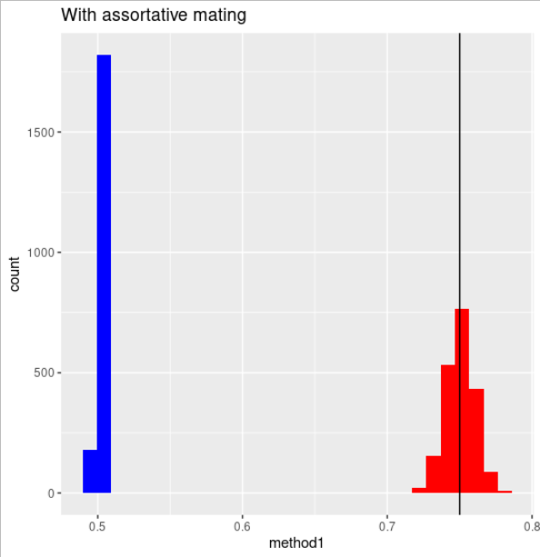
What we did
Efficiency (lesson 3) and robustness against mistaken assumptions (lesson 4): we used two estimation methods and outlined situations where each of them works better.

Slide 7
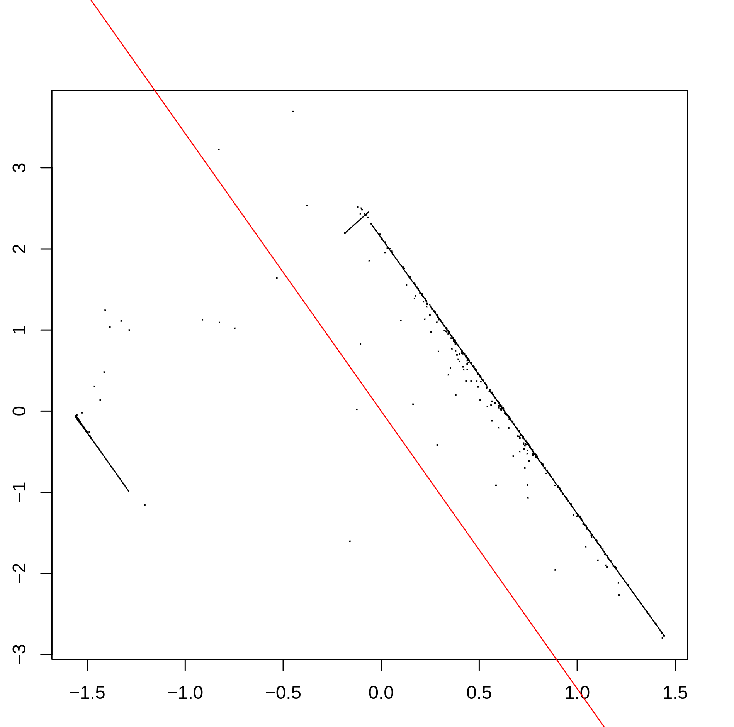
What we did
Outliers (session 5):
We studied outlier robustness of the mean and median (“Bill Gates walks into a cafe.”)
We studied a linear regression problem where the overall trend was clear, but hard to capture statistically due to outliers.
Estimate slope locally within each “bin”
Find median slope across bins

Slide 8
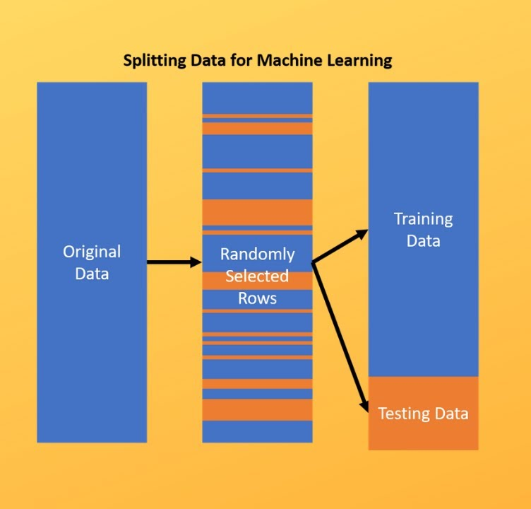
Y = b₀ + b₁X₁ + b₂X₂ + b₃X₃
X given; b unknown
What we did
Model selection (lesson 6): We selected subsets of three “predictor” variables on an outcome, based on three criteria.
“Best fit to the sample” always uses all predictors
“Null hypothesis testing” uses a predictor only if it clears a strict standard of evidence
“Train-test split” is in between

Slide 9
Priorities of different fields
Applied math: no measurement error
Most intro stats: well-understood measurement error
Modern stats research: poorly understood measurement error
Most modern ML: “We want good predictions and we don’t care how the system we’re studying actually works.”
You can borrow from anyone whose priorities match your priorities.

Slide 10
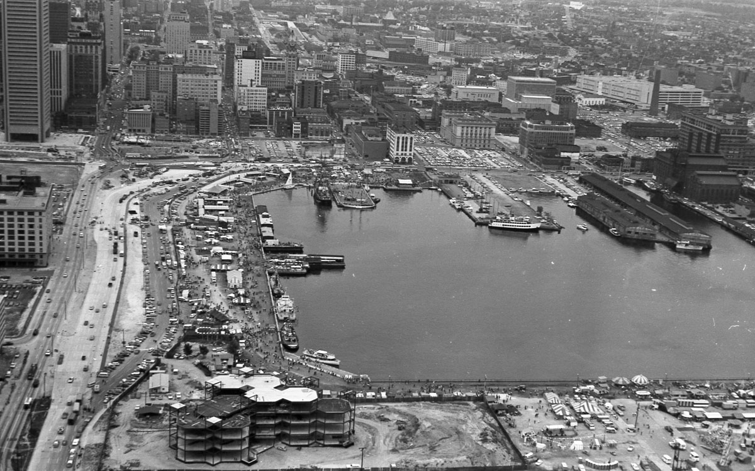
I hope you can:
Get stuff done
Take a bird’s-eye view
Image from the Baltimore Sun darkroom: Inner Harbor during the 1973 City Fair.
https://darkroom.baltimoresun.com/2016/10/a-birds-eye-view-of-baltimore-in-1973/#1

